Slide 1
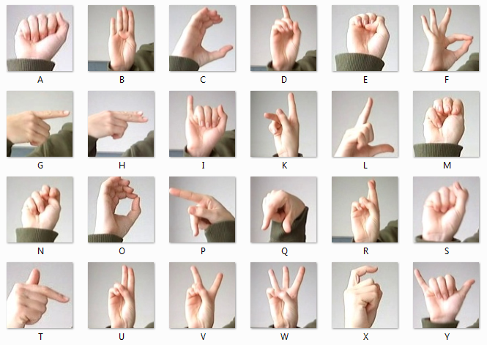
SIGN LANGUAGE DETECTION
Team Members:
Nachammai Devi Pooja S – 185001096
Prashanth S – 185001111
Prathyush S – 185001112
Ramaprabha R – 185001123

Slide 2
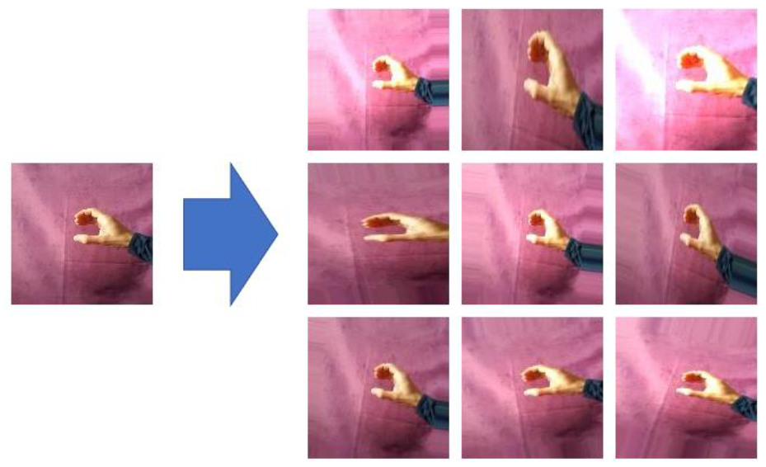
Problem Statement
The Hand gestures made using the sign language are detected and displays the letter along with the accuracy.
If many letters are shown continuously then it should be detected as a word and displayed respectively.

Slide 3
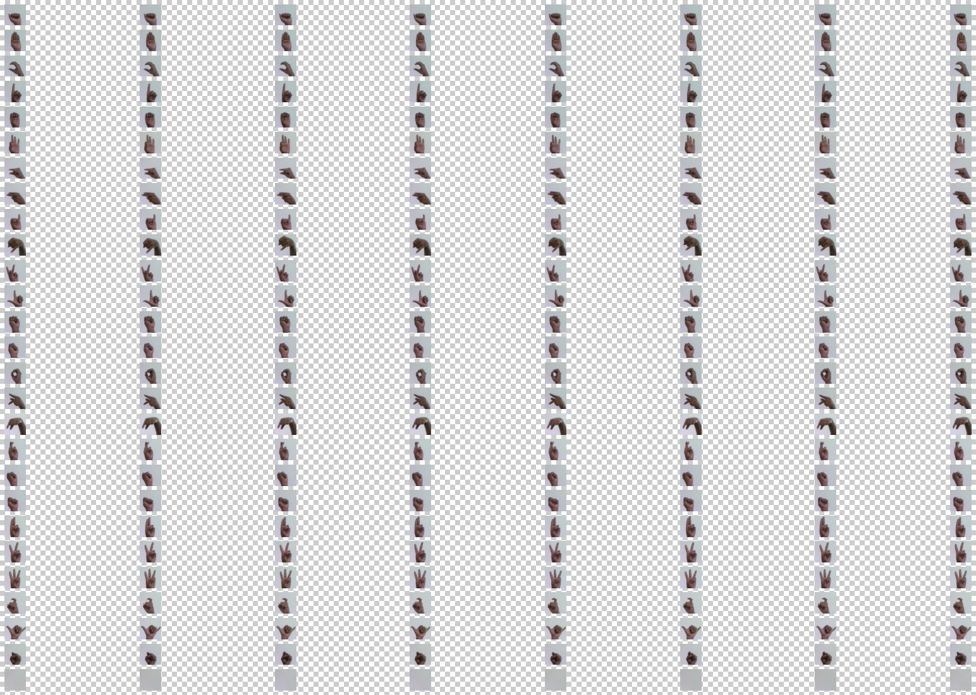
Dataset
User generated Dataset
We have done 120 images per output class.
The size of the dataset = Cmxn
=120 x 27
=3240

Slide 4
Methodology
Convolutional Neural Network (CNN):
It is a neural network that has one or more convolutional layers and are used mainly for image processing, classification, segmentation and also for other auto correlated data.
The layers of a CNN consist of an input layer, an output layer and a hidden layer that includes multiple convolutional layers, pooling layers, fully connected layers and normalization layers
NASNET-Mobile:
NASNet-Mobile is a convolutional neural network that is trained on more than a million images from the ImageNet database.
As a result, the network has learned rich feature representations for a wide range of images. The network has an image input size of 224-by-224.

Slide 5
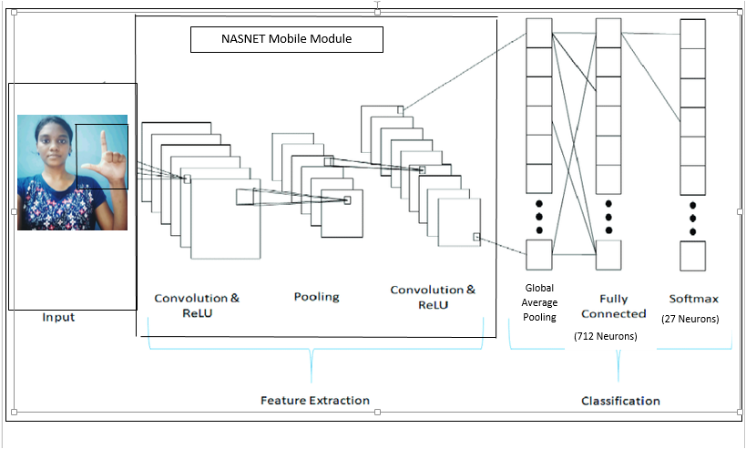

Slide 6
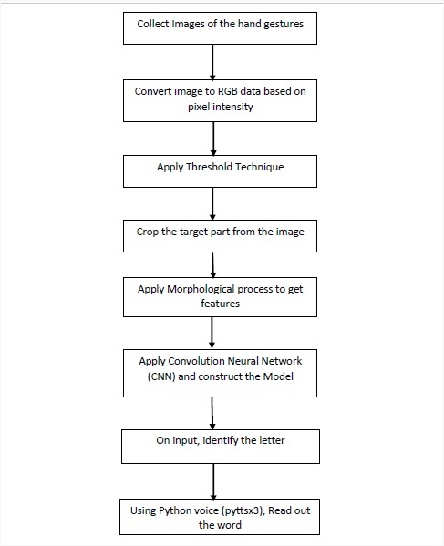

Slide 7
Functionality
Open cv:
It is a cross-platform library using which we can develop real-time computer vision applications.
It mainly focuses on image processing, video capture and analysis including features like face detection and object detection.
Matplotlib-Pyplot:
Draw Figures and Plot Graphs
Tensorflow & Keras (For Image Processing & Image Conversion):
Keras is a deep learning API written in Python, running on top of the machine learning platform TensorFlow.
It was developed with a focus on enabling fast experimentation.

Slide 8
Adam Optimizer:
Adam is a replacement optimization algorithm for stochastic gradient descent for training deep learning models.
Adam combines the best properties of the AdaGrad and RMSProp algorithms to provide an optimization algorithm that can handle sparse gradients on noisy problems
Dropout:
To avoid Over fitting and Over Sampling by deliberately blocking few neurons from activation during training.

Slide 9
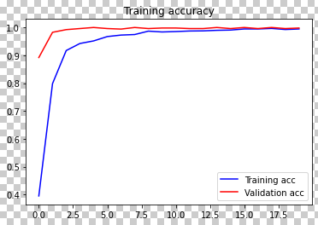
Error calculation Metrics
Training Accuracy is usually the accuracy you get if you apply the model on the training data.

Slide 10
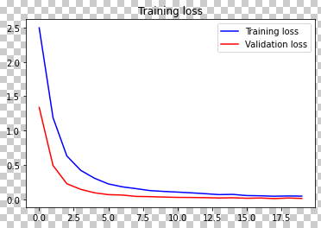
Validation loss is the same metric as training loss, but it is not used to update the weights.

Slide 11
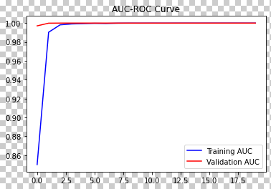
AUC-ROC Curve

Slide 12
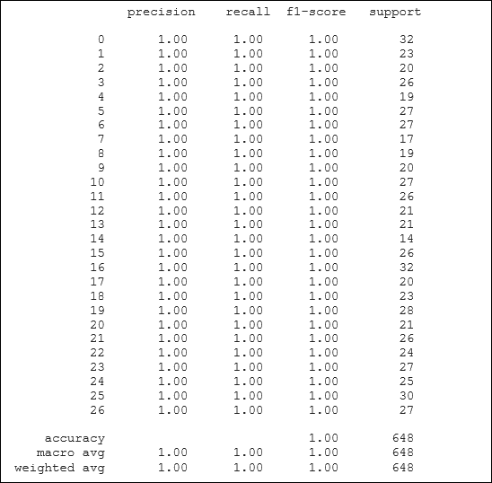
Accuracy, Precision, Recall, F1-score

Slide 13
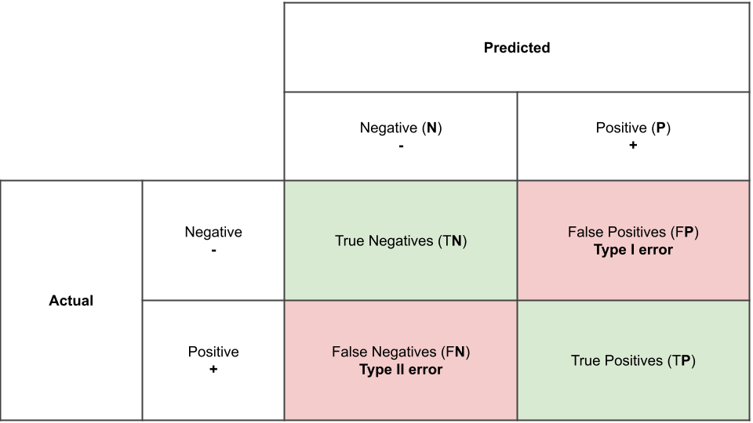
Confusion Matrix
A confusion matrix is a table that is often used to describe the performance of a classification model (or "classifier") on a set of test data for which the true values are known.

Slide 14
Thank You

